Slide 1
Toronto Crime Analysis : Pre, During & Post COVID
Malick Ly

Slide 2

OVERVIEW OF ANALYTICS
Objective :
The purpose of this analysis is to assess the impact of the COVID-19 pandemic on major crime incidents across Toronto by:
Comparing crime data across three distinct time periods:
Pre-COVID (Before March 2020)
During COVID (March 2020 – May 2023)
Post-COVID (After May 2023)
Identifying trends in crime rates over time and evaluating any significant shifts linked to lockdowns and public health restrictions.
Classifying and analyzing the different categories of crimes (e.g., assault, theft, break and enter, etc.) to determine which types were most affected during the pandemic.

Slide 3


Selected columns for analysis:
-Occurrence Date : for time-based analysis
-Offence : Specific crime committed
-Major Crime Indicator Category : Crime category
-Neighbourhood_140 : Useful for geographic analysis
-LAT and LONG : Crimes on a map
KPIs:
Total Number of Crimes Crime
Rate Change % (Between the periods)
Top 5 most criminogenic neighbourhoods
Highest Crime Per Period
Pre vs During vs Post Covid Crime Counts

Slide 4
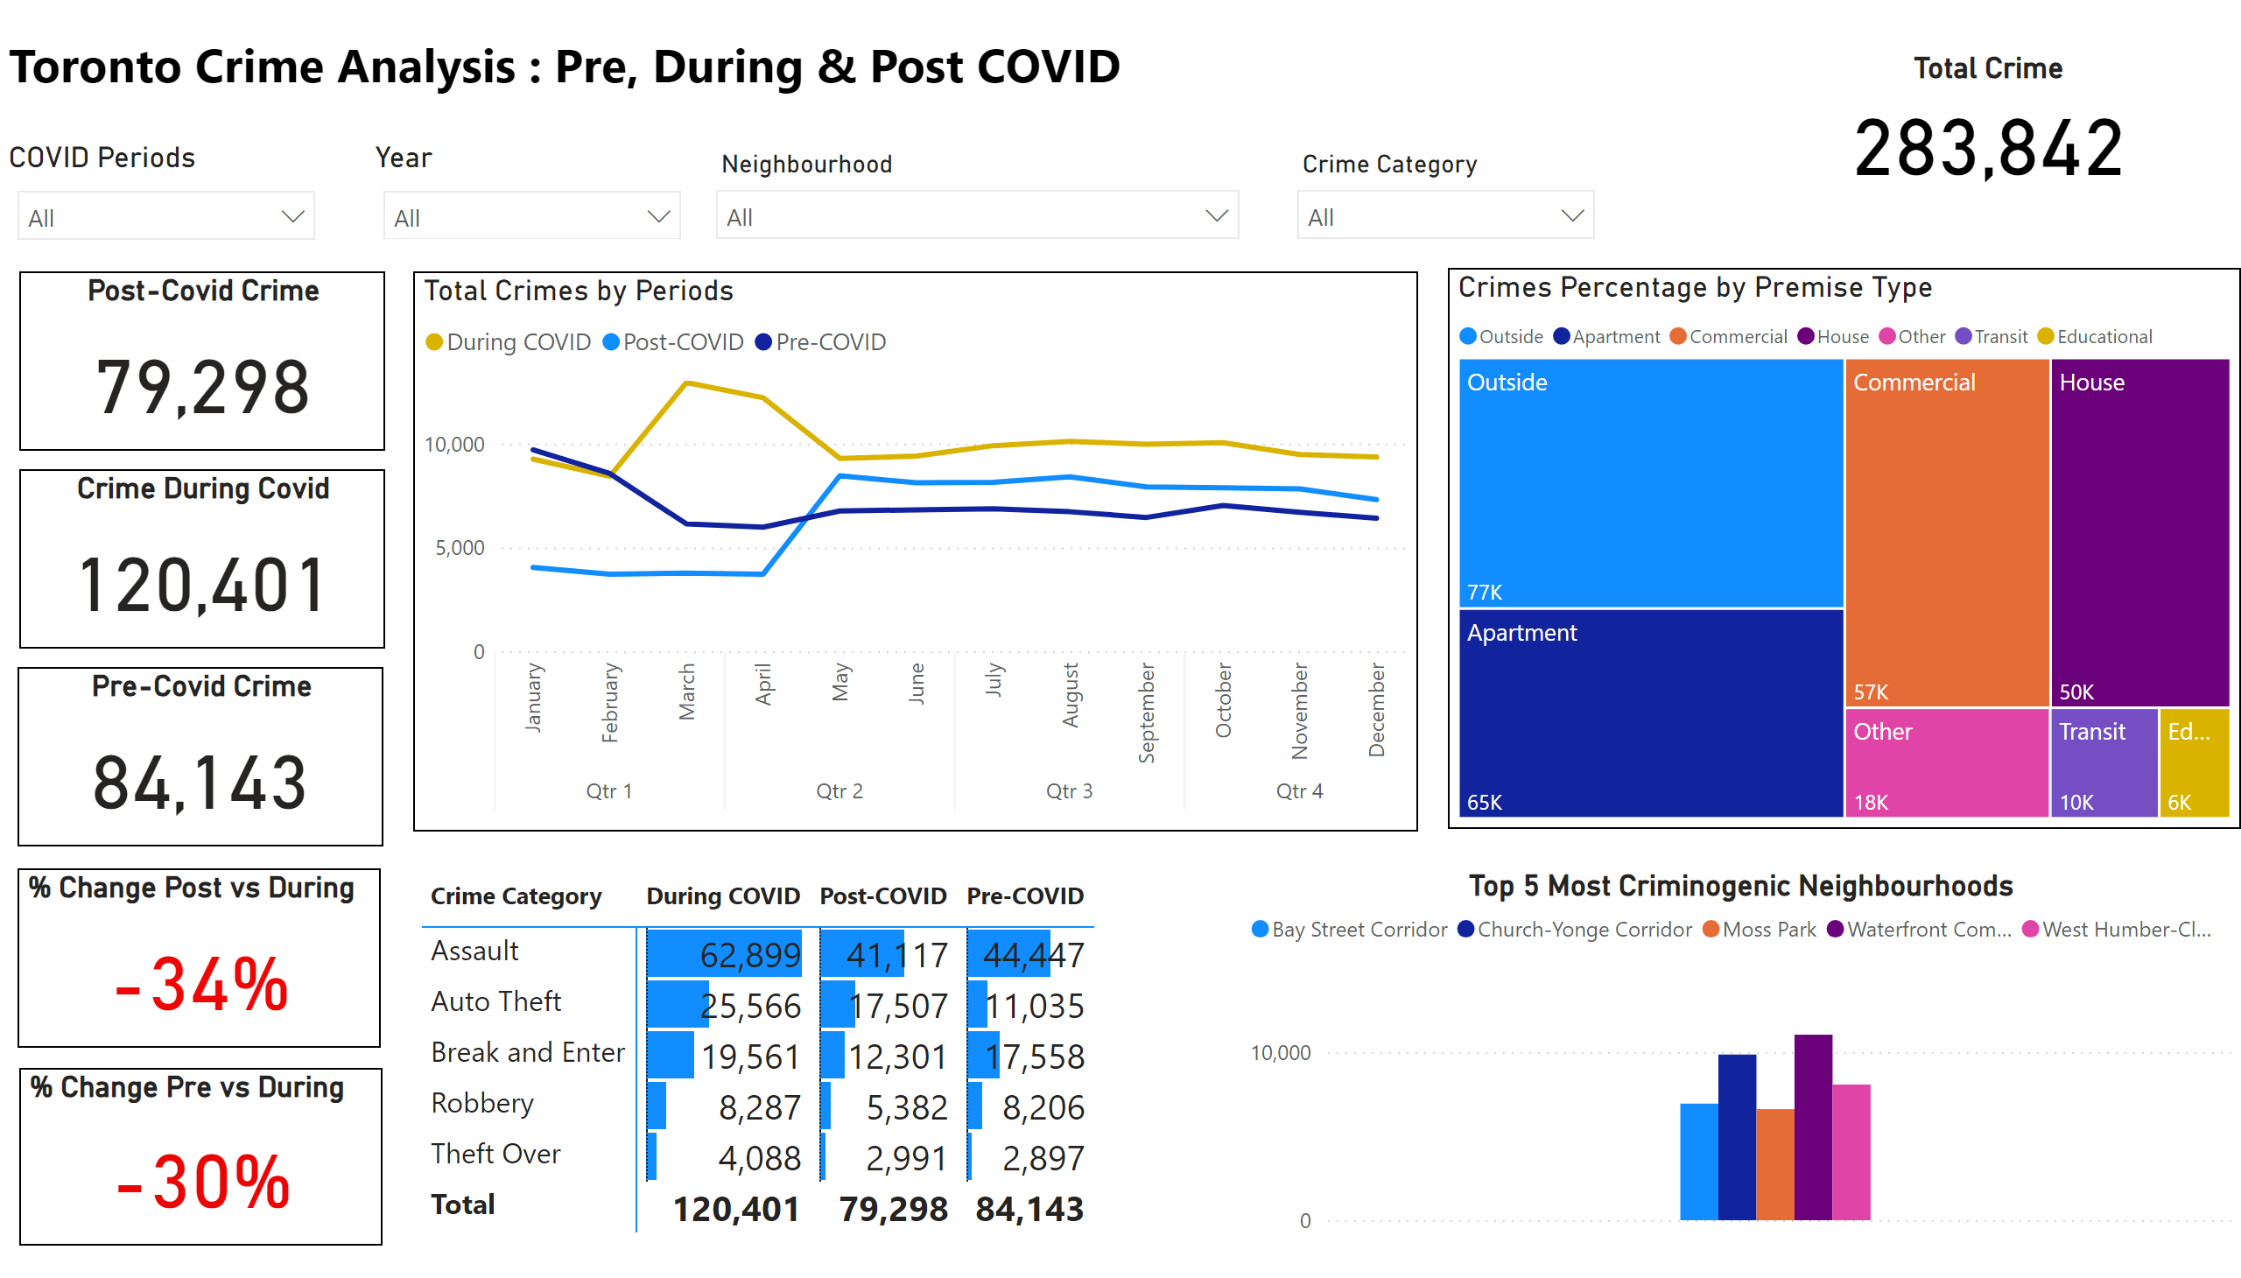
Crime Report
Notes:
textbox
No alt text provided
COVID Periods
No alt text provided
Year
No alt text provided
slicer
No alt text provided
slicer
No alt text provided
Total Crime
No alt text provided
Post-Covid Crime
No alt text provided
Crime During Covid
No alt text provided
Pre-Covid Crime
No alt text provided
Total Crimes by Periods
No alt text provided
Crimes Percentage by Premise Type
No alt text provided
% Change Post vs During
No alt text provided
% Change Pre vs During
No alt text provided
pivotTable
No alt text provided
Top 5 Most Criminogenic Neighbourhoods
No alt text provided

Slide 5
Crime Analysis:
During Covid period had the highest total crime volume, in comparison, Pre-Covid recorded 84143 incidents, while Post-Covid saw a decline to 79298. This spike during the pandemic likely reflects the social and economic uncertainty caused by lockdowns, including reduced public interaction and increased financial pressures on households. The drop in Post-Covid numbers suggests a partial return to normal.
Assaults rose during Covid went from 44477 in Pre-Covid to 62899 incidents during Covid likely due to domestic violence and stress-related incidents. Auto Theft more than doubled during the pandemic and remained higher Post-Covid, possibly linked to the car chip shortage, the appreciation of used car market and the reduced of police patrols.
The top 5 criminogenic neighborhoods overall are : Bay Street Corridor, Church-Yonge Corridor, Moss Park, Waterfront Communities and West Humber-Clairville. But for post covid we saw Mimico and Islington-City Centre West replacing Moss park and Bay street Corridor in the ranking. Further investigation is needed to determine if this is shifting.

Slide 6
RECOMMENDATIONS:
Recent shifts in crime patterns highlight emerging hotspots in Mimico and Islington-City Centre West, signaling a need for increased law enforcement presence to prevent further escalation. Meanwhile, auto thefts remain high post-pandemic, requiring proactive measures such as public awareness campaigns and neighborhood patrols to discourage future offenders.
In addition, the rise in assaults during COVID was likely driven by stress and domestic tensions. This underlines the urgent need to expand mental health services and family support programs to address the root causes and prevent future incidents.
To help the police improve their efforts, we can adopt the NYC model by deploying mobile police kiosks in hotspot areas. Additionally, we should integrate CCTV with AI video analytics and acoustic sensors to pinpoint gunfire locations and dispatch police within seconds just like in Philadelphia.
The solutions are among us, but without political and financial commitment, even the best systems won't succeed.

Slide 7
Sources:
Interactive Link :
https://app.powerbi.com/reportEmbed?reportId=14f7e091-15cf-41e9-be84-29365b50a264&autoAuth=true&ctid=416d9044-c24a-462e-91a6-186a2a379d18
Toronto-Crime-Report-with-PowerBI/ at main · DKR514/Toronto-Crime-Report-with-PowerBI
Ontario government declares state of emergency amid coronavirus pandemic | Globalnews.ca
Data source: https://www.tps.ca/data-maps/open-data/

